Slide 1

Genai in the classroom: Lessons and Challenges
Klaire Somoray
Psychology Lecturer (4th year program)

Slide 2
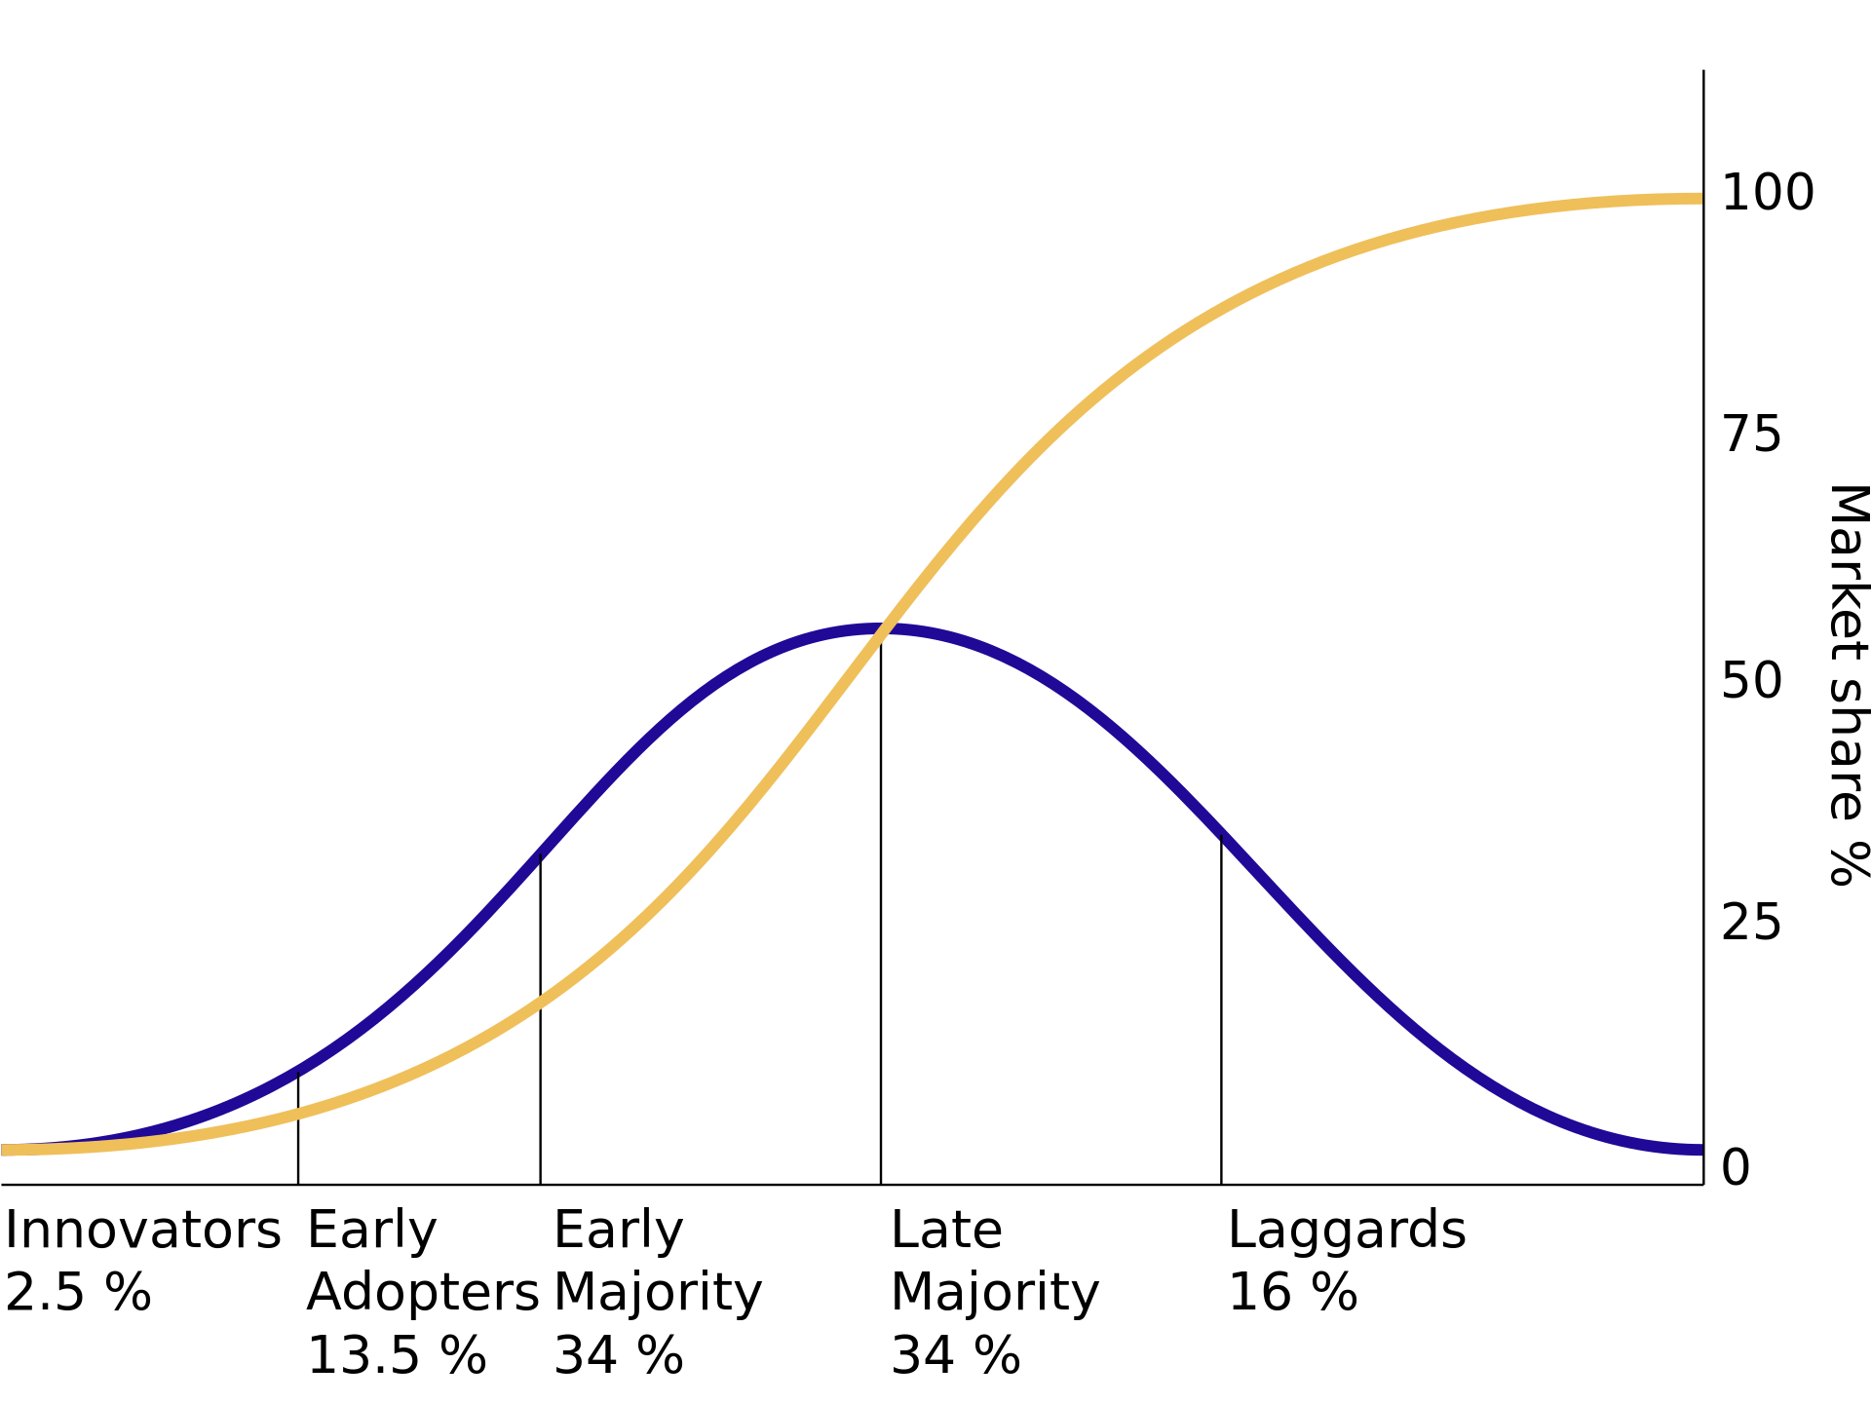

Educator’s positionality
My research focuses on the intersections of data, technology and their societal impacts, with a particular interest in human-computer / human-AI interaction and how big data and algorithms impact our everyday lives.
Diffusion of innovations theory
Notes:
Need to think about my positionality in this topic given that my teaching philosophy is deeply guided by my bias towards new technology and AI (I am definitely in the early adopter according to the Diffusion of Innovation Theory).
LLMs is not great in systems-thinking (a big part of my teaching philosophy) – you need to prompt it to think of the systemic-level evaluation. Unfortunately, I feel like students will only think of systems-level thinking if they are already familiar with this. See this following exchange I had with ChatGPT in regards to the topic of VR therapy among young people with PTSD: https://chatgpt.com/share/e475f099-fed0-429e-af58-5ff50ffea74a

Slide 3
Class activities / assessment
Teaching demonstration of Claude, Co-Pilot and Perplexity
Talked about how they differ and how different LLMs have different purposes
Learned that most students only knew about ChatGPT
GenAI image generation and biases of generated image (used Adobe Firefly)
Class had a lot of fun trying to generate images by giving me prompt to make the images more diverse
Ethics of using AI-tools in Psychology Practice
Shows how student haven’t thought about privacy issues of client information
I’ve asked them how they would feel if health professionals used sensitive data about their medical conditions/trauma/personal history to feed training models, even if data is deidentified.
Talked about transparency of AI use with clients
Class discussions on the future of AI in the mental health space (e.g., thoughts on therapeutic chatbots)
Had some great discussions on the space that psychologists/mental health professionals can take in the world of AI
Submission of GenAI declaration form
Critical reflection on the use and non-use of GenAI to complete their critical review
Notes:
Class discussions on hoe students see AI being used in psychological practice? Should we use AI to take notes of our clients? If so, should there be protocols on how we go about this?

Slide 4
Lessons learnt so far…
Approximately one-third of the students stated that they have heard about it but do not want to use it
AI Anxiety – our students have a lot it!
Need critical thinking about data ethics, privacy and transparency
When we talked about how AI can be used in future psychological practice, students said it’s okay to use AI to take client notes…… is it?
Quite a few students said that the first time they’ve used GenAI was in my subject.
Humbling experience lol
Notes:
Q: Would I be disadvantaged if I don’t use it (I think those who use it has an unfair advantage of using GenAI) ?
A: There are many things that can make learning “unfair” that is outside of AI use (e.g., needing to work full-time while studying).

Slide 5
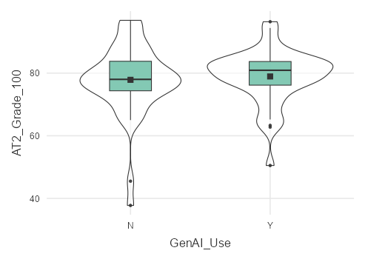
Lessons learnt so far…
Out of N = 93, 41 (44.1%) said they used GenAI in their second assessment which is a reflective piece.
Interestingly, when asked to specify how they used GenAI, n = 4 students specifically mentioned using Grammarly for their assignment
Common use include:
Check for grammatical errors
Improve sentence structure
Enhance overall flow of writing
Receive feedback on their drafts (incl. suggestions for editing, structuring paragraphs)
Help in getting their writing more concise and clearer
ns
Group difference was not significant, p = 0.628 d = 0.11

Slide 6
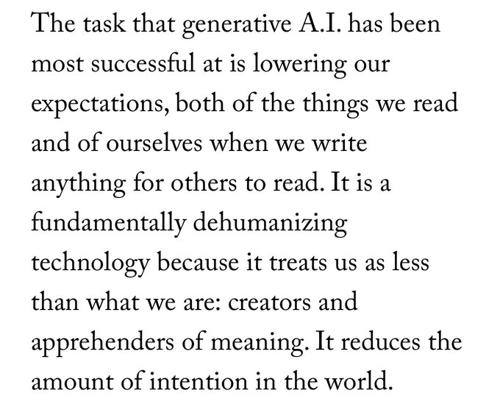
Problems relating to AI that are beyond Academic Integrity
Resource incentive and impact on climate change
Risk of technological determinism – where AI is seen as inherently progressive
AI as another tool of control
Over-reliance on AI
Ted Chiang, ref: https://www.newyorker.com/culture/the-weekend-essay/why-ai-isnt-going-to-make-art
Notes:
https://www.technologyreview.com/2024/05/23/1092777/ai-is-an-energy-hog-this-is-what-it-means-for-climate-change/
https://www.nytimes.com/2023/03/08/opinion/noam-chomsky-chatgpt-ai.html

Slide 7
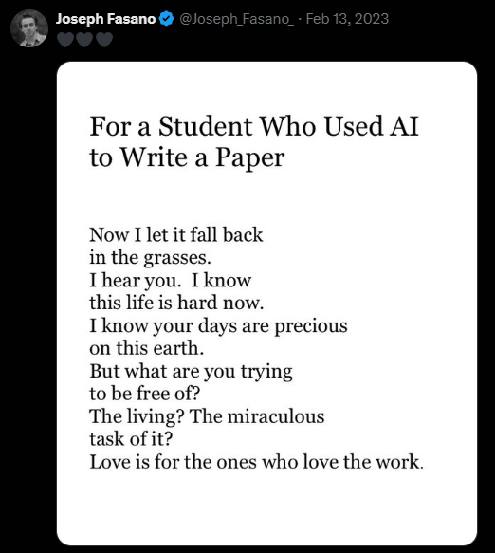
How am I going to engage AI next time I teach?
Show students the value of writing as a process by which we develop our thinking and our ideas
Cognitive labour should be worthwhile!
Stop making assumptions about students’ use of AI
Not everyone wants to use it!
Notes:
Ideas from Josh Brake’s Substack: Here’s how I’m engaging AI This Fall

Slide 8
Books to read if you are interested in the critical context of AI
Unmasking AI – Joy Buolamwini
Weapons of Math Destruction – Cathy O’Neil
The Alignment Problem – Brian Christian
AI Atlas – Kate Crawford
Great resource regarding the issues with AI that do not get a lot of attention in our conversations (e.g., environmental impact, invisible labour required by these automated systems)
Invisible Women: Exposing Data Bias in a World Designed for Men – Caroline Criado-Perez
Not specific to AI but have some great critiques about big data using the lens of intersectional feminism

